Slide 1


Rohan Raj (11011896)

Slide 2
Outline
Introduction
Architecture
Data Preview
Data Preparation
Models training and candidate model
Demo
Conclusion

Slide 3
Introduction
Analytics India Magazine in partnership with Imarticus Learning hosted the hackathon
Increase of 384%* in the number of cars from 2001 to 2016
Knows the prices of used cars across the country
Cars are more than just a utility
* According to Statistical Yearbook India 2018

Slide 4
Introduction

Slide 5
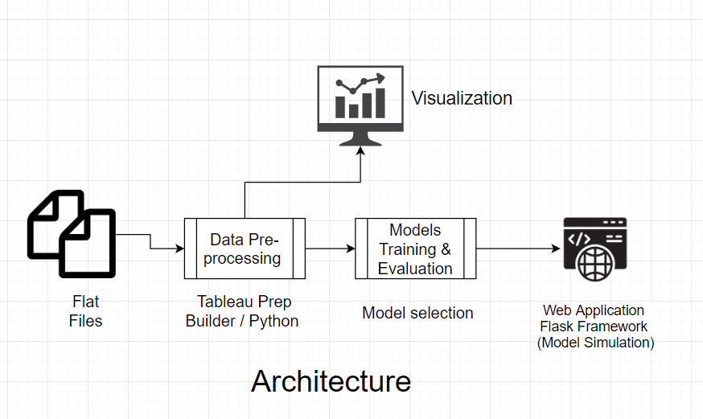
Architecture

Slide 6
Data Preview
The data collected from various sources and distributed across various locations in India.
7036 records in dataset

Slide 7
Data Preparation
Dealing with Categorical variable
Name encoding (Ex Audi A4 2.0 TDI -> 14)
Normalization
Geo-coding and others

Slide 8
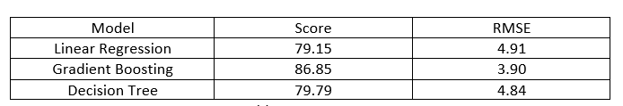
Models training and candidate model
Linear regression, Decision Tree Repressor, and Gradient Boosting Regressor
Model Selection will be based on High score and low Root Mean Squared error.

Slide 9
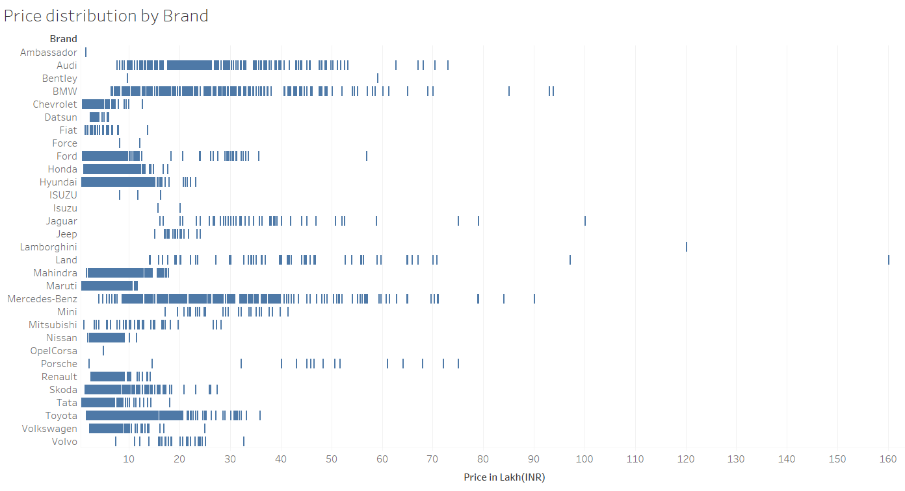
Exploratory Analysis and Visualization
Price distribution over brand
The popular Brand such as Chevrolet, Ford, Honda Hyundai, Mahindra, Maruti, Nissan.... had a stable range of price, in other words they are not well diversified on the price axis.

Slide 10
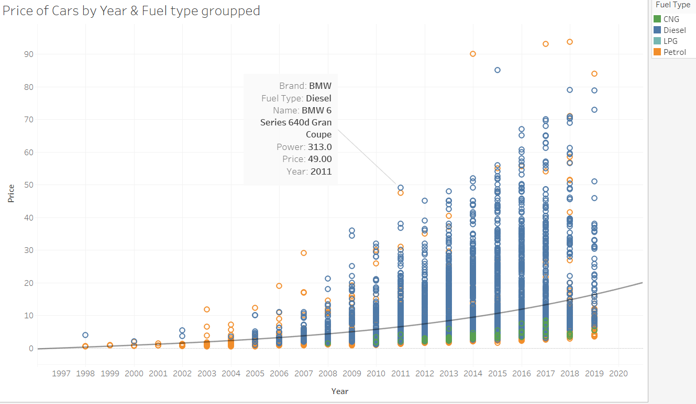
Exploratory Analysis and Visualization
Price distribution over year grouped by fuel type
Price increase can also be seen, or it may be because of the data we have most of them are belongs to 2011-2018 span. But Price increment can visualize on brand level also. CNG fuel type of vehicle is only available after 2008.

Slide 11
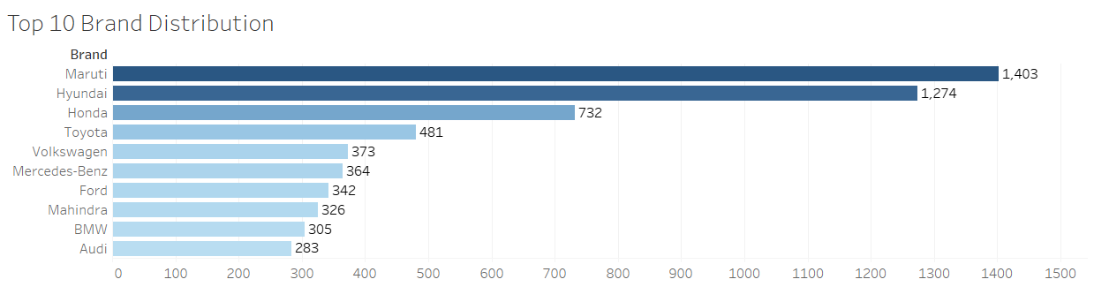
Exploratory Analysis and Visualization
Brand distribution
Price increase can also be seen, or it may be because of the data we have most of them are belongs to 2011-2018 span. But Price increment can visualize on brand level also. CNG fuel type of vehicle is only available after 2008.

Slide 12
Demo

Slide 13
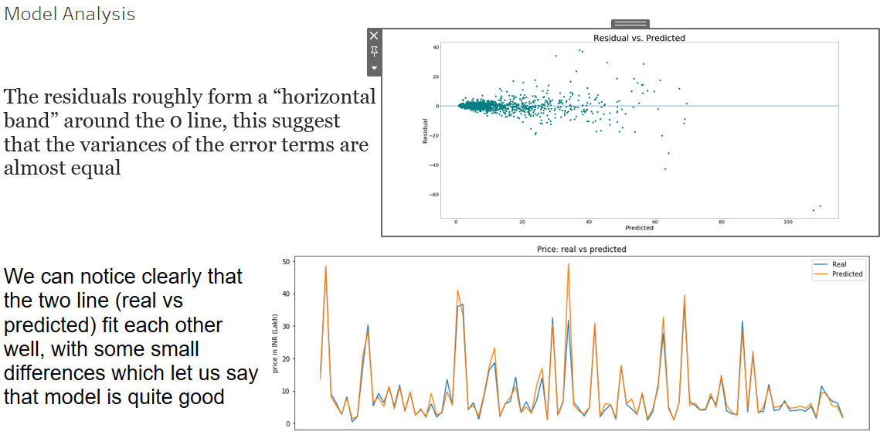

Slide 14
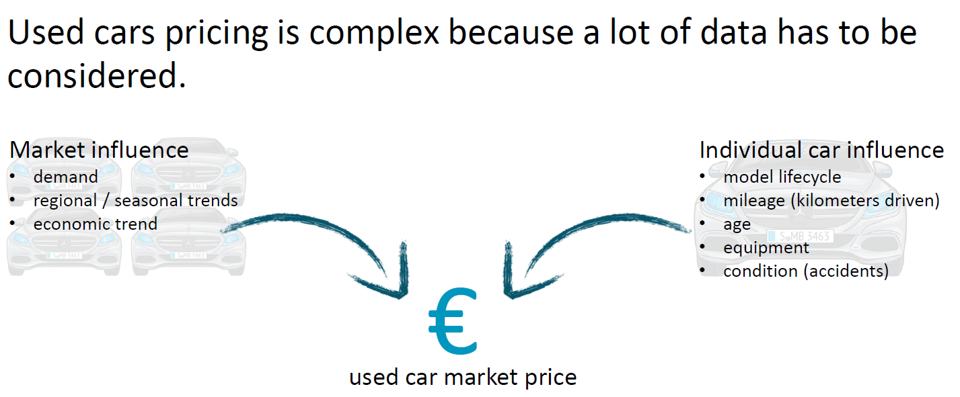
Conclusion

Slide 15
Thank you

